Slide 1
Lead Scoring Case Study
By – Kumari Madhumita
Krishna
Ramya Konathala

Slide 2
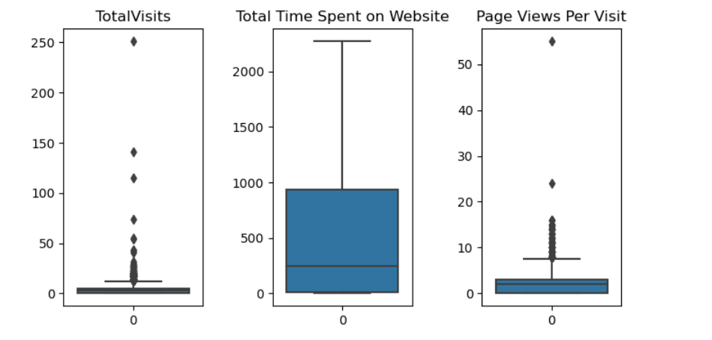
Data Analysis
Checked the dimensions, data types, uniqueness of lead file data.
Removed the redundant values which were not helpful for data analysis.
Checked for outliers present in data set, for variables ‘Total Visits’ & ‘Page Views per Visits’ there are outliers present so we capped it with “Quartile3+1.5*IQR”.

Slide 3
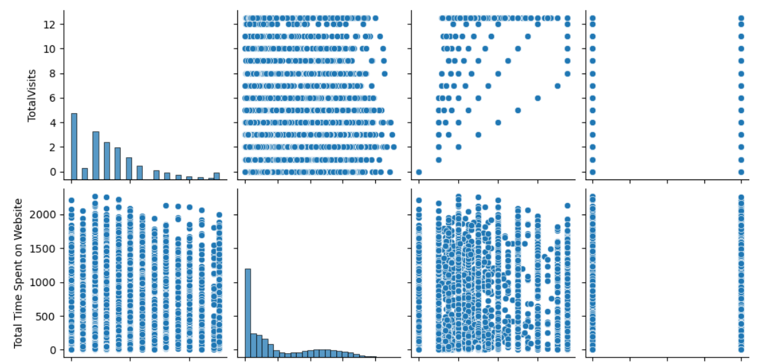
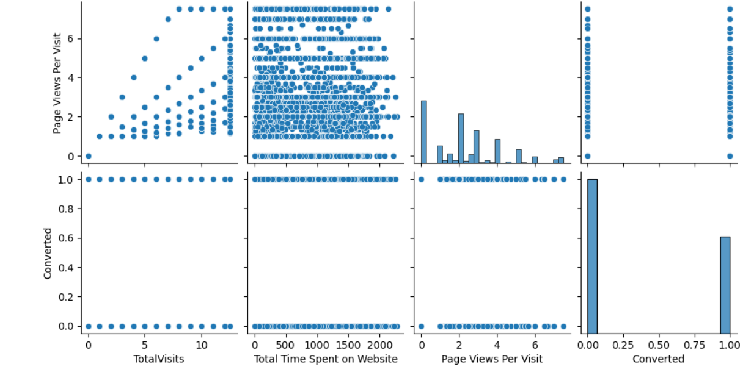
Data Visualization
We have created pair plots for numerical variables.

Slide 4
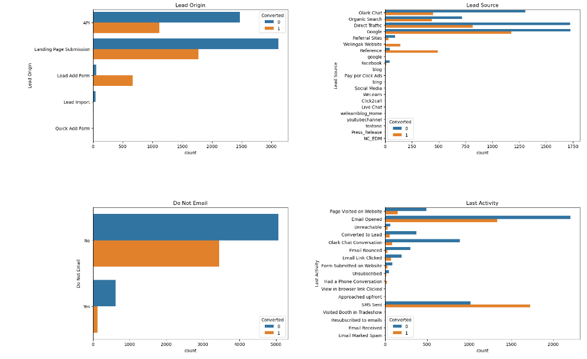
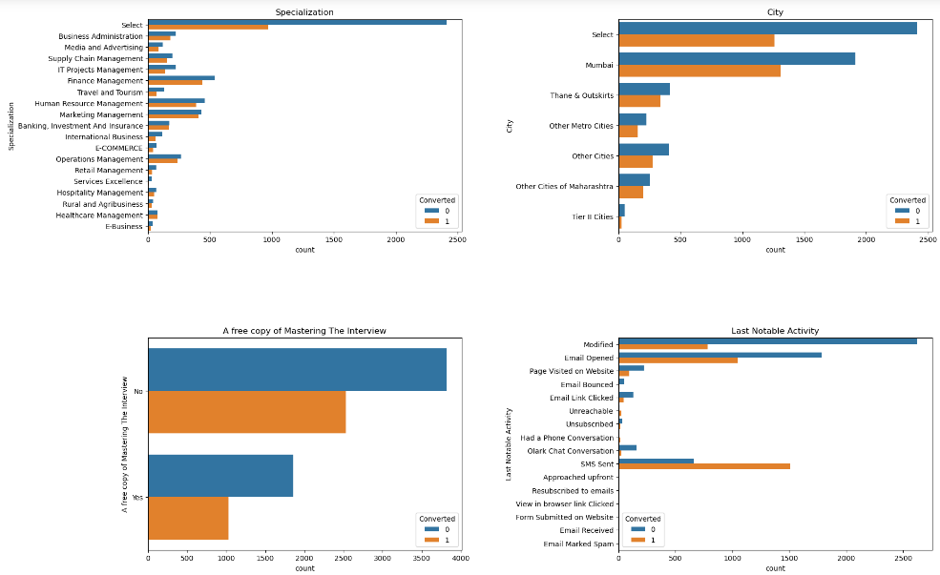
Data Visualization
We have created count plots for categorical variables.

Slide 5
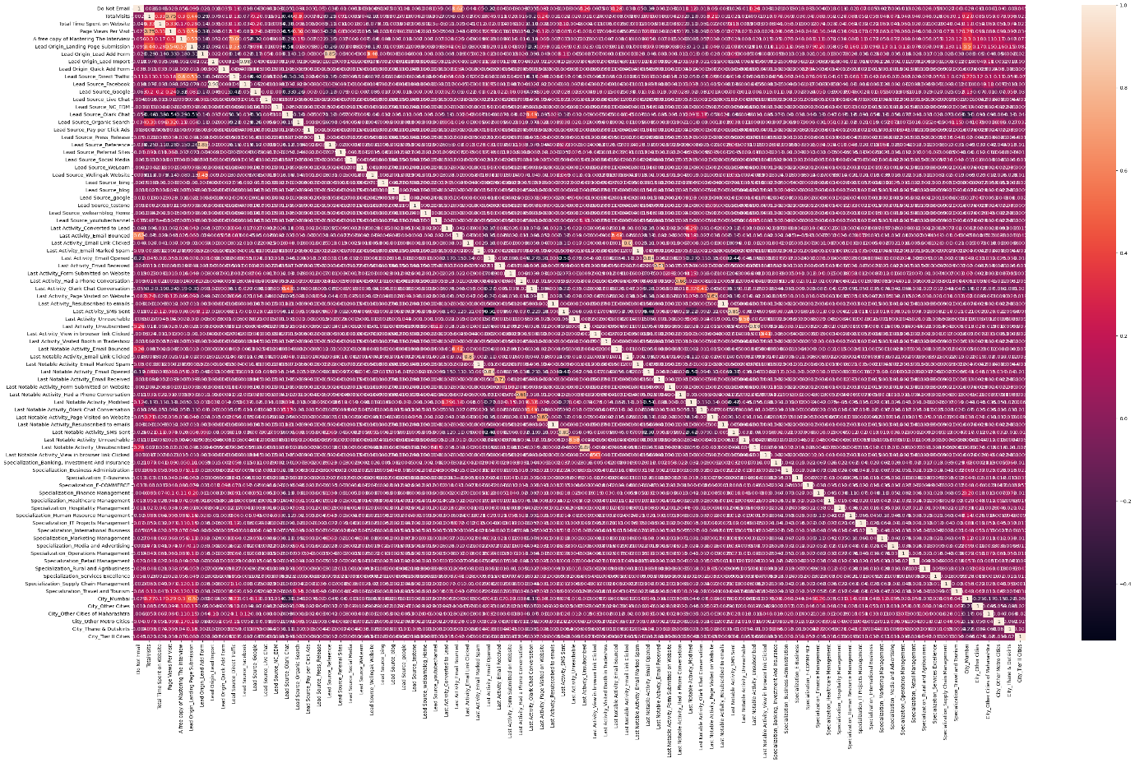
Data Visualization
We have checked for correlations, since there are lot of variables present, we could not able find much information.

Slide 6
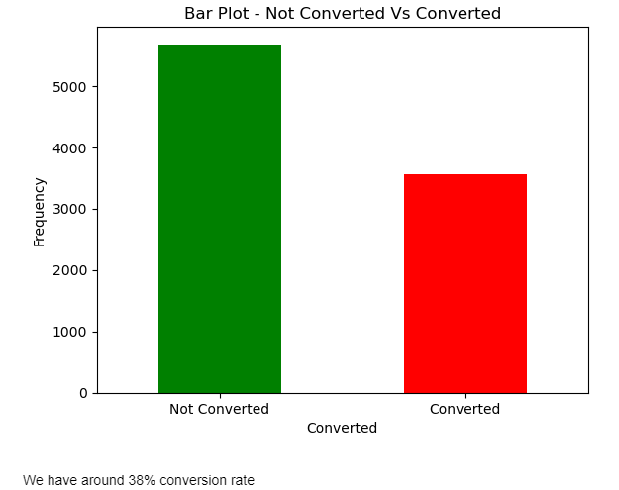
Test-Train Split
We have used test-train split to find the conversion rate of leads i.e. it’s 38%.

Slide 7
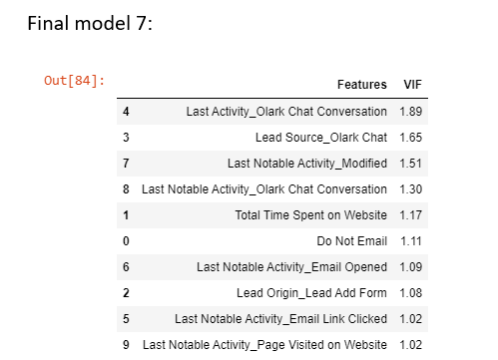
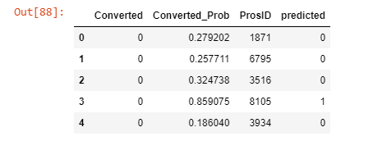
Model building & Evaluation
We have used RFE & VIF in model building, model 7 has less p-value and VIF hence, considered the correct one.
We have used the previously calculated converted_prob to find the prediction of lead getting converted or not.

Slide 8
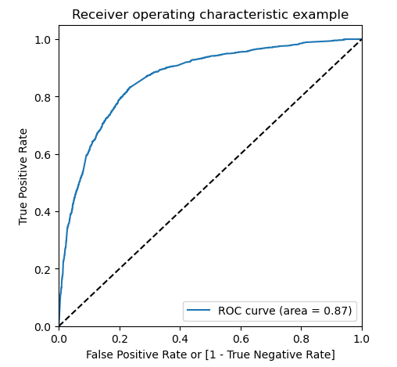
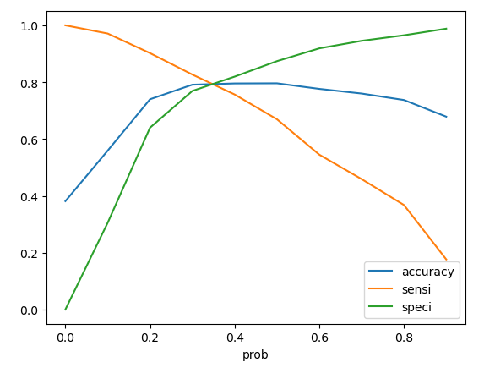
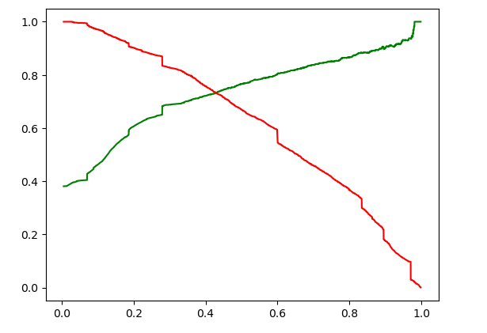
ROC Curves
It shows the trade off between sensitivity and specificity (any increase in sensitivity will be accompanied by a decrease in specificity).
The closer the curve follows the left-hand border and then the top border of the ROC space, the more accurate the test.
The closer the curve comes to the 45-degree diagonal of the ROC space, the less accurate the test.

Slide 9
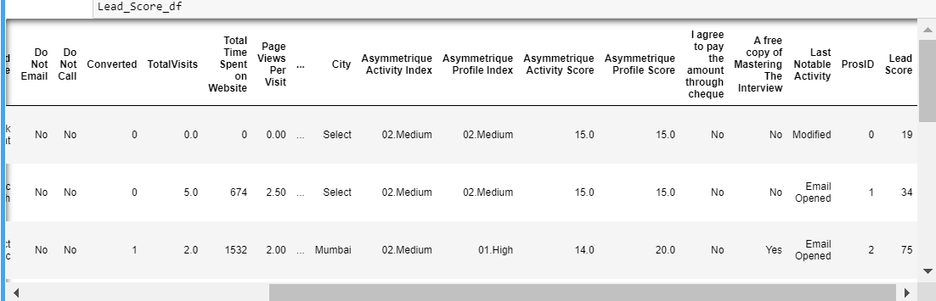
Leading Score Value
We have derived lead score value from previously calculated converted_prob and using y_train_pred_final. In the end, each row is having a lead score value.

